Slide 1
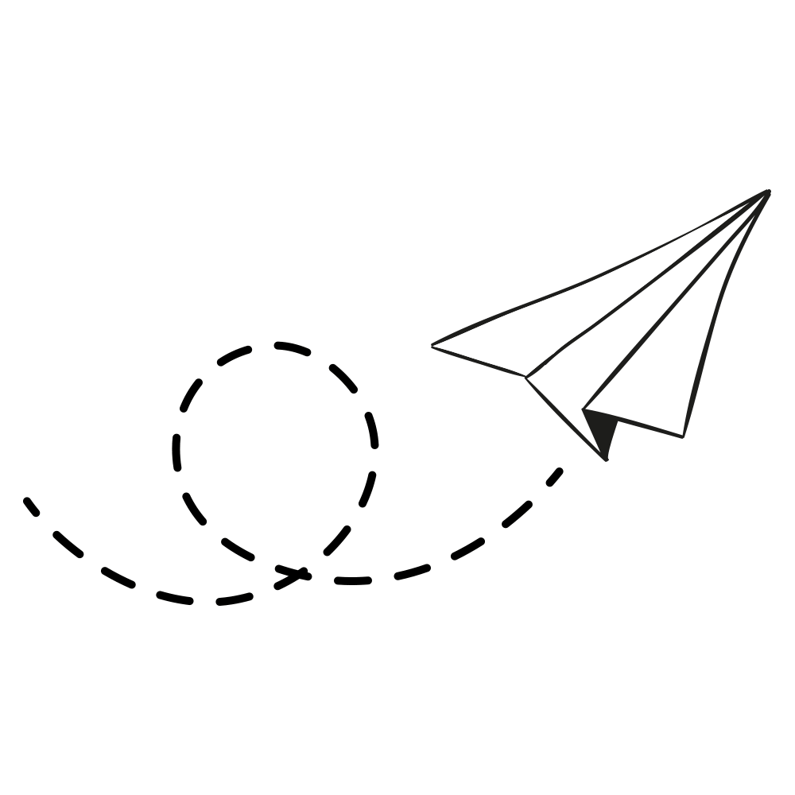
TRIPPY Your Journey, Our Passion
Quad Coders-106
Tony Kurian (248740)
Vivek Kumar P V (248784)
Ashna Shamsudeen (249416)
Shyma Paul (249387)

Slide 2
PROBLEM STATEMENT
Develop a comprehensive solution to get the best airline route possible. When travelers are searching for routes between two destinations, the system should provide solutions with the minimum travel duration and the least amount of inconvenience caused by layovers and connecting flights. The system is expected to provide the optimum response within 30ms.

Slide 3
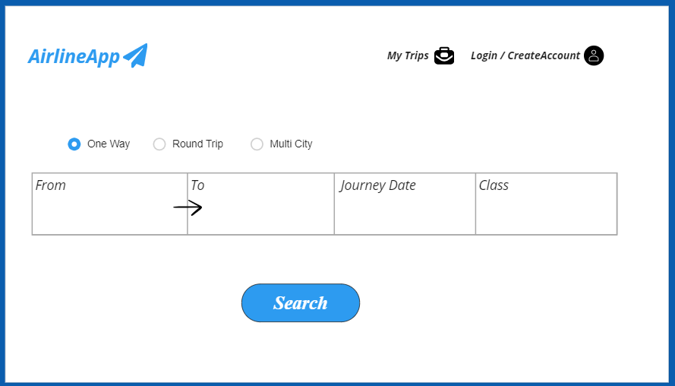
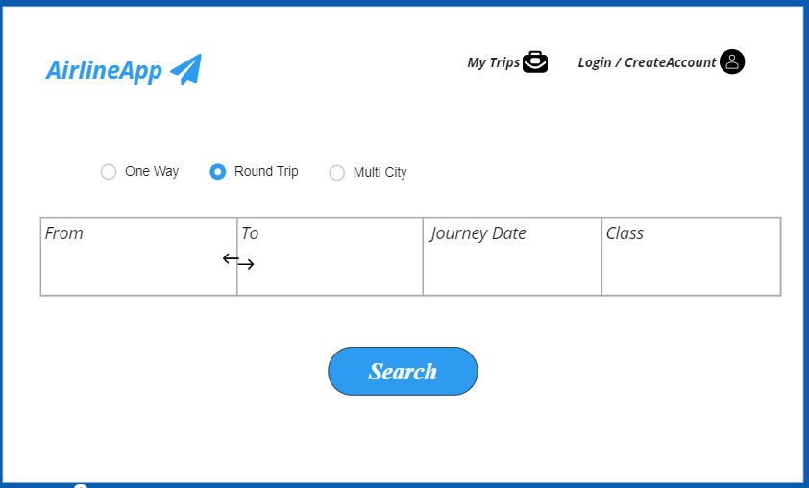
WIREFRAME DESIGN

Slide 4
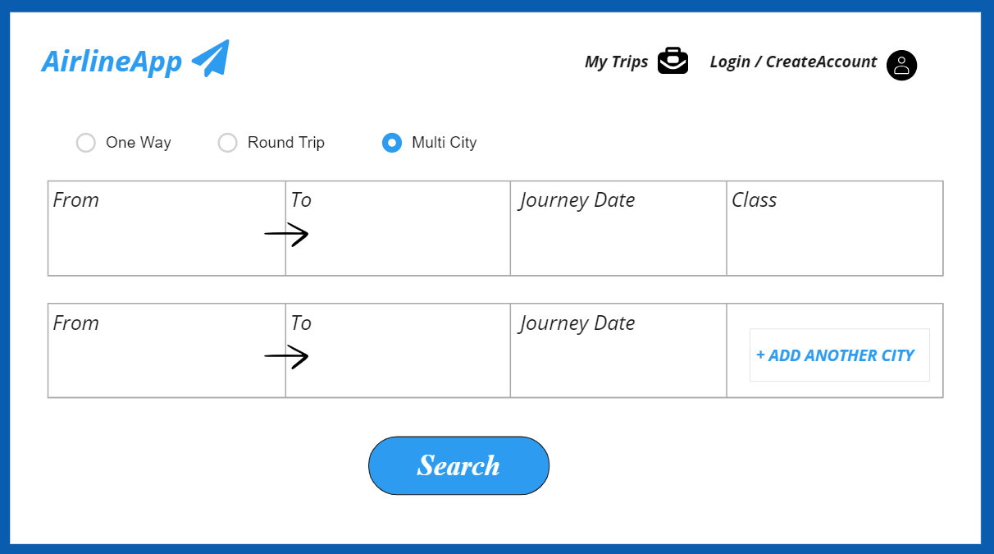
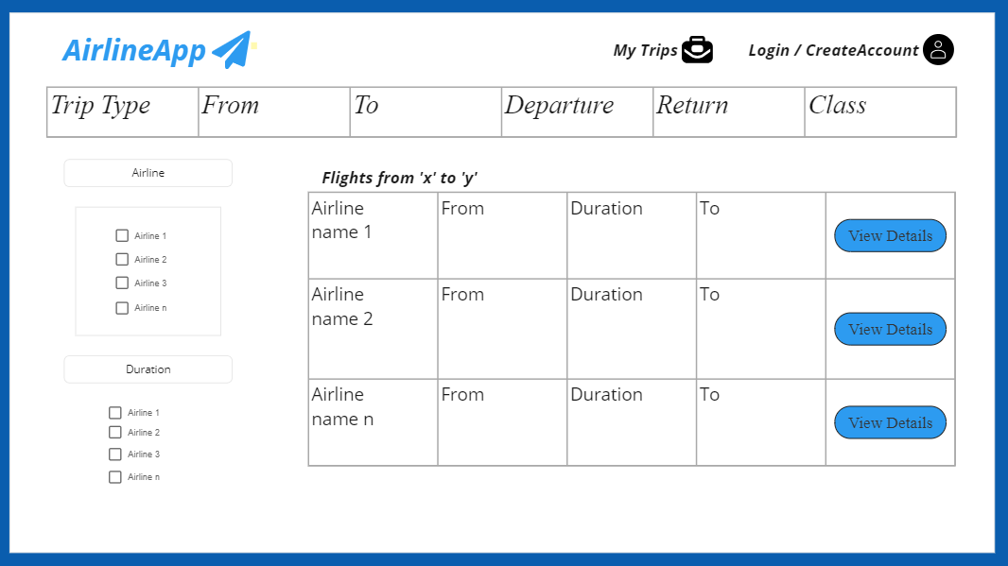
WIREFRAME DESIGN (Cont..)

Slide 5
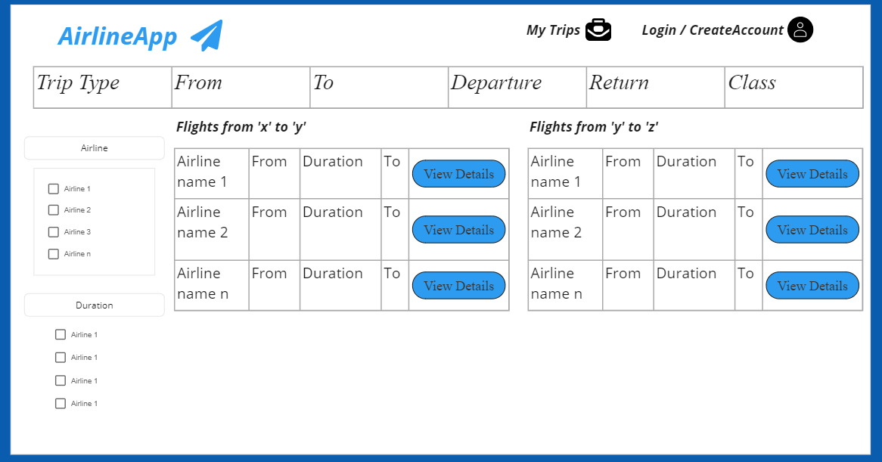
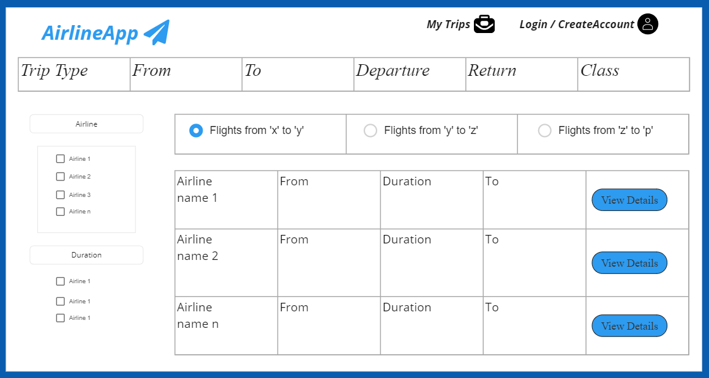
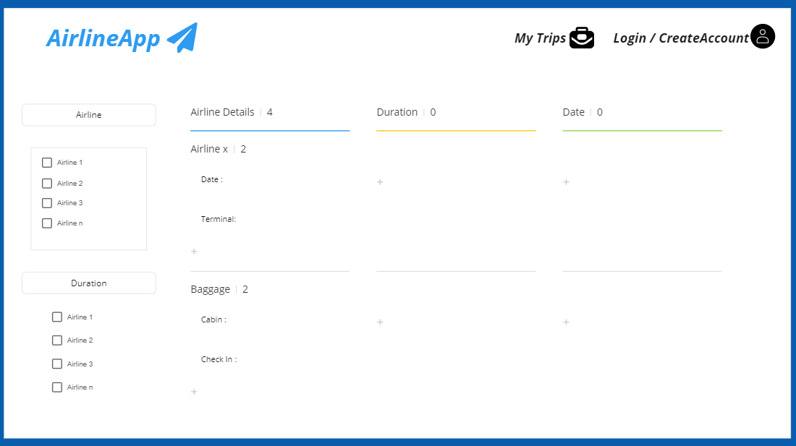
WIREFRAME DESIGN (Cont..)

Slide 6
Database Design
AIRLINE
id | long
code | string
is_lowcost | Boolean
logo | String
name | String
created_on | LocalDateTime
modified_on | LocalDateTime

Slide 7
Database Design
AIRPORT
id | long
code | long
name | String
country | String
latitude | double
longitude | double
city | String
state | String
ICAO | String
created_on | LocalDateTime
modified_on | LocalDateTime

Slide 8
Database Design
ROUTE
id | long
iata_from | String
iata_to | String
airline_iata | String
day1 | Boolean
day2 | Boolean
day3 | Boolean
day4 | Boolean
day5 | Boolean
day6 | Boolean
day7 | Boolean
max_duration | LocalDateTime
min_duration | LocalDateTime

Slide 9








Technologies Used
Python
JAVA
MYSQL
MongoDB
React
Bootstrap
Spring Boot
Fast API
Fast API

Slide 10
Week 1
Analysed the problem statement.​
Brainstormed our ideas.​
Installed required applications.​
Collected JSON file of airport , airline and route details.

Slide 11
WEEK 2
Fetched airport ,airline and route details and saved data in the designed database using APIs.​
Developed APIs for fetching airline and airport using the IATA code.​
Developed an API to list best recommendations.​
Added filters for accepting multiple class and airline types.​
Designed flight recommendation end points ,which can handle multiple.​
Developed an API to list the airport based on the input search string.​
Developed an APIs to get detailed itinerary information.

Slide 12
Week 3
Started front-end and designed the wireframe.
Wireframe designed using Miro.
Used python and fast API as framework along with Java and Spring Boot.
Started front-end coding
Used React as Front-end tool
Pushed the code to GitHub

Slide 13
THANK YOU!

